Slide 1
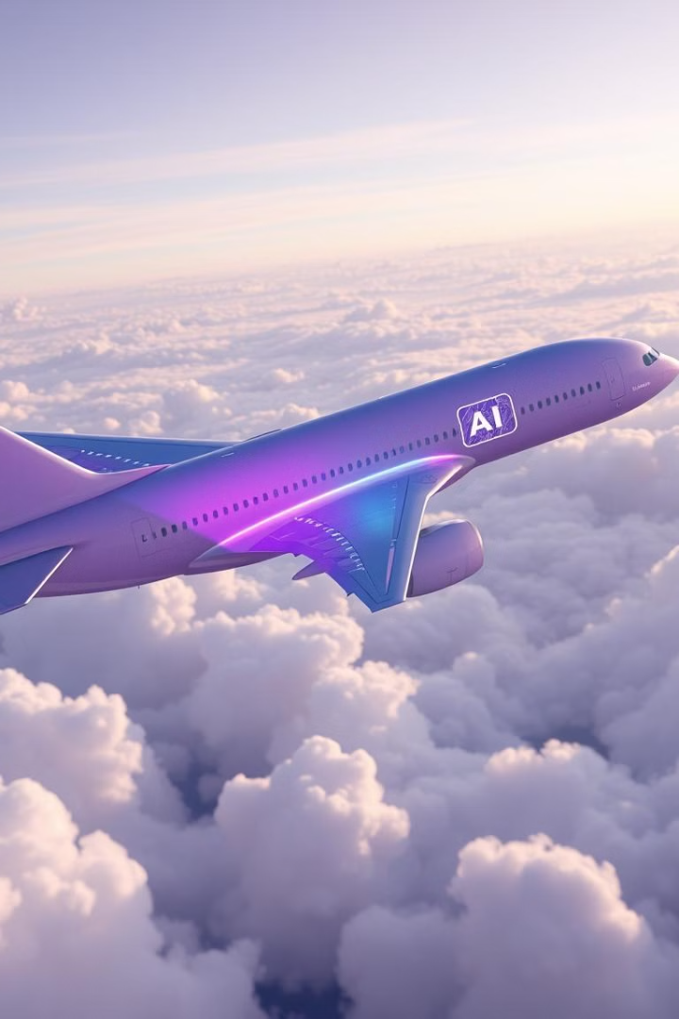
Airline Customer Satisfaction
Asmi Panigrahi
Qi Yuan
Xuhui Zheng
TEAM : 9

Slide 2

Problem Statement Exploration:
An Introduction
Current Scenario
Project Aim
Airlines today operate in an environment where customer satisfaction plays a critical role in business success. Passengers have diverse expectations, and dissatisfaction can lead to negative reviews and reduced loyalty, ultimately impacting an airline's revenue.
In this project, we aim to address this challenge by analyzing a dataset of airline passenger's feedback. Our primary objective is to identify the key factors that influence satisfaction and use predictive models to uncover patterns of dissatisfaction.
Project Objectives
Through this analysis, we intend to provide actionable insights to help airlines enhance their customer experience. This includes improvements in inflight service, comfort, and other travel-related aspects.

Slide 3
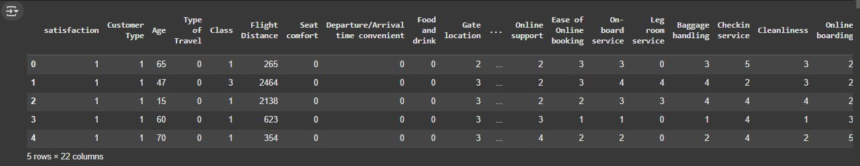
Dataset Overview: Uncovering Passenger Insights
Dataset Overview
Key Findings
Invistico Airline Satisfaction dataset comprises 5 rows and 22 columns after cleaning. We focused on features like satisfaction level, customer type, travel type, seat comfort, and others.
Preprocessing: Missing values handled, duplicates removed, categorical variables encoded.
The dataset exhibited a balanced satisfaction distribution with 54.7% satisfied and 45.3% dissatisfied passengers.

Slide 4
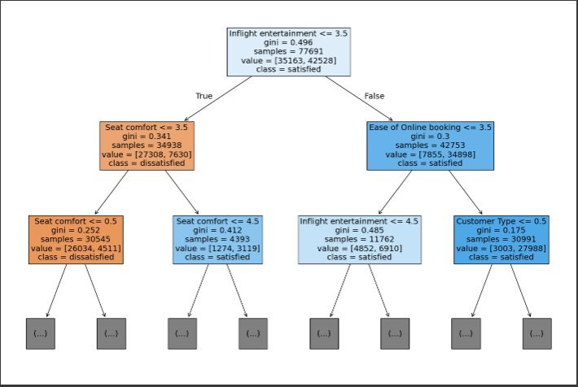
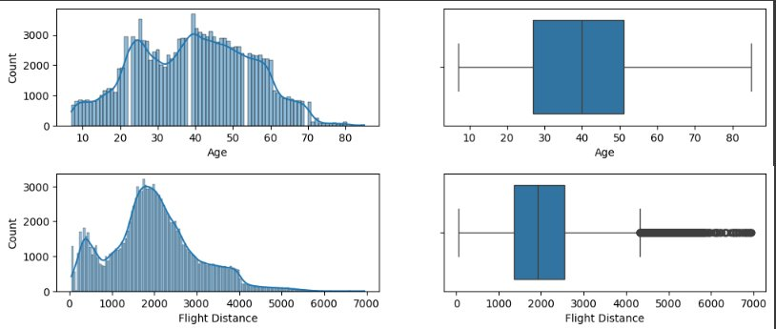

Dataset Overview, Continued…
Figure 2:
Decision Tree Plot
Figure 3:
Boxplot Count vs Age & Count vs Flight Distance

Slide 5
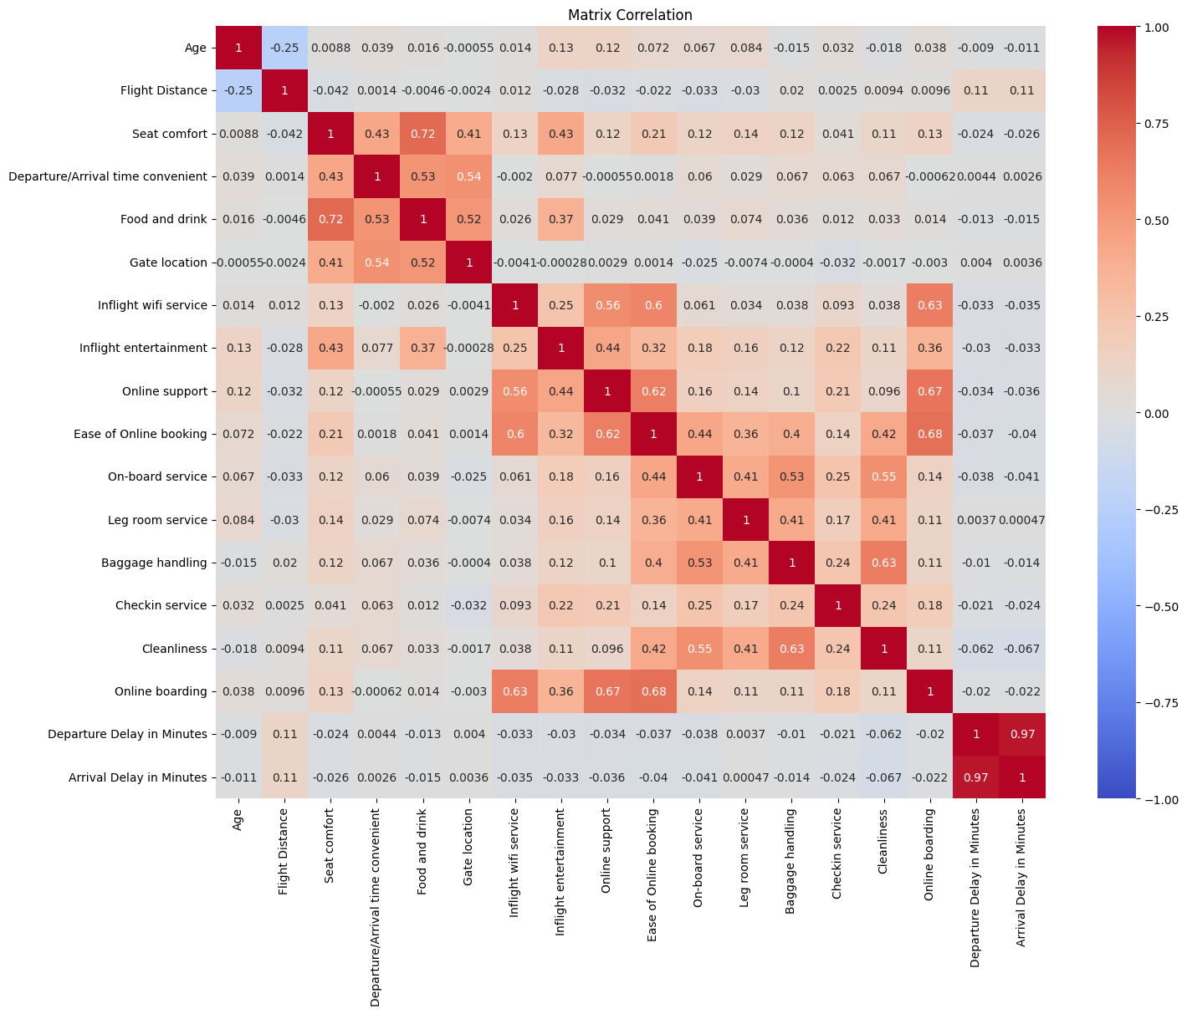
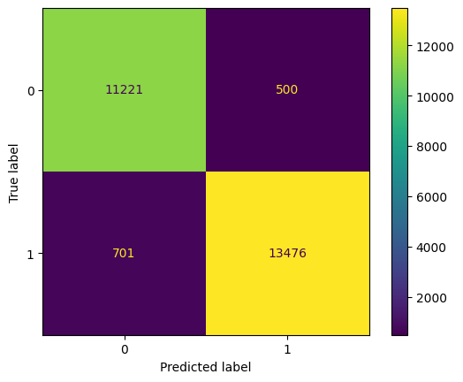
Dataset Overview, Continued…
Figure 4:
Matrix Correlation Chart
Figure 5:
Confusion Matrix – Random Forest

Slide 6

Problem Statement Analysis
Airlines operate in a competitive industry where customer satisfaction is essential for keeping passengers and fostering loyalty. However, analyzing the aspects that influence satisfaction can be difficult due to the complexity and diversity of passenger expectations.
Dissatisfaction leads to bad feedback and customer turnover, which have a direct impact on an airline's income and reputation.
To address this, we examined a dataset of passenger input on topics such as seat comfort, in-flight service, and simplicity of booking. Using exploratory data analysis, we discovered important satisfaction drivers such as seat comfort, in-flight entertainment, and check-in service.
For example, satisfied airline customers are more likely to recommend an airline and repurchase tickets (Kim and Lee, 2011), which contributes to an airline's profitability and increased market share (Buttle, 1996; Dagger et al., 2007; Devlin and Dong, 1994).
By using these information, we hope to equip airlines with actionable solutions for increasing happiness and decreasing dissatisfaction.

Slide 7

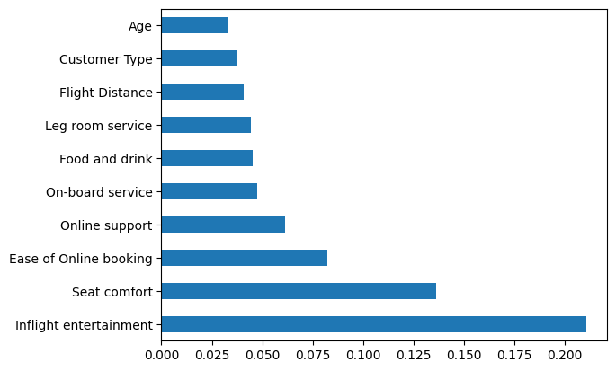
Use Case Scenarios
Airline satisfaction data presents numerous chances to improve the passenger experience.
Predictive modeling is a prominent use case. Airlines can detect unsatisfied passengers and solve their concerns ahead of time by studying passenger feedback. For example, if a passenger is
displeased with the in-flight entertainment, they may be offered personalized material or gratis upgrades.
Another application is resource optimization. Airlines can speed check-in operations or prioritize premium seating on flights with a high volume of business customers. On the other hand, on long-haul flights, efforts can be directed toward improving seat comfort and meal quality.
Finally, airlines can implement real-time sentiment tracking. Staff may address complaints promptly by assessing passenger comments during flights, such as dealing with delays or improving in-flight service.
These application cases show how AI-driven insights may directly boost customer pleasure, loyalty, and business success.

Slide 8
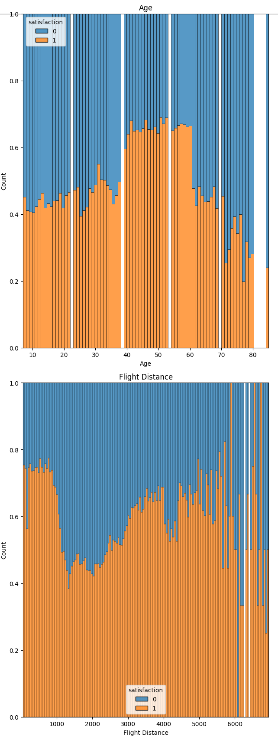
AI Algorithms & Models
Our investigation used a variety of AI techniques to predict passenger pleasure.
They featured Decision Trees, Random Forests, and XGBoost.
1
Decision Trees
Decision Trees offered an intuitive comprehension of feature splits, but they lacked the robustness required for this complicated dataset. To improve performance, we employed Random Forests, which integrate numerous decision trees to avoid overfitting and increase accuracy.
2
XGBoost
Feature importance analysis proved invaluable. Identifying key factors like seat comfort and in-flight service provided actionable insights for airlines to improve the passenger experience.
3
Random Forest
We faced challenges like class imbalance and computational limits during hyperparameter tuning. We addressed these through sampling techniques and optimizing GridSearch parameters for efficiency.
These findings illustrate Random Forest's ability to generate useful insights from complex data. This model is not only accurate but also interpretable, making it a viable option for airlines seeking to improve customer happiness.

Slide 9



Results & Demonstrations:
Our analysis yielded useful insights and accurate forecasts about passenger pleasure. We compared numerous models, including Decision Trees, Random Forests, and XGBoost.
The Random Forest model achieved impressive results:
Accuracy: 0.95 %
Precision: 0.96 %
Recall: 0.95 %
F1-Score: 0.95 %
These results demonstrate the model's ability to accurately predict passenger satisfaction with minimal errors. Our findings demonstrate the model's ability to accurately classify both satisfied and unsatisfied passengers with few errors.
These findings and application cases demonstrate how artificial intelligence may assist airlines in identifying discontent trends
and taking action to improve the passenger experience, resulting in increased loyalty and revenue.

Slide 10




Feature Importance: Determining Top Predictors of Satisfaction
Seat Comfort
Seat Comfort is the most important factor in determining enjoyment. Airlines should give maximum priority to providing comfortable seating, especially on long-haul flights. Airlines should also increase investment in ergonomic designs and offer increased legroom.
In-flight Service
In-flight service is valued by passengers for its attentiveness and quality. Airlines should increase their focus on offering diverse meal choices, attentive and diligent staff, and varied entertainment options.
Ease of Check-in
Smoother check-in processes considerably improve the overall experience. This entails streamlining check-in procedures, user-friendly digital solutions, personalized mobile applications, and multiple self-service kiosks in order to reduce wait times and enhance the overall experience.

Slide 11

Lessons Learned: Key Insights
1
Data Preprocessing
First, we learned the importance of data preprocessing, handling missing values, removing duplicates, and encoding categorical variables were crucial steps to ensure model accuracy and reliability.
2
Feature Importance Analysis
Second, we realized that feature importance analysis is invaluable. Identifying key factors like seat comfort and inflight service helped us understand what matters most to passengers and provided actionable insights for airlines.
3
Class Imbalance and Computational Limits
Third, we faced challenges such as class imbalance and computational limits during hyperparameter tuning. Addressing these required creative solutions like sampling and optimizing GridSearch parameters for efficiency
Finally, this project highlighted the potential of AI in solving real world problems. By leveraging machine learning, airlines can predict dissatisfaction, enhance passenger experience, and build long-term loyalty. In the future, we aim to extend this analysis to real-time data, enabling airlines to respond proactively to passenger feedback mid-flight.

Slide 12
Q&A:
Thank you for your interest! We are now open to answering
any questions you may have concerning our project.
Please feel free to ask questions concerning our dataset, the AI
models we employed, the insights we discovered, or how these
discoveries may be applied to real-world airline operations.

Slide 15


Slide 19
Dataset Exploration: Uncovering Passenger Insights
Dataset Overview
Key Findings
The dataset comprised 5 rows and 22 columns after cleaning. We explored features like satisfaction level, customer type, travel type, seat comfort, and others. The dataset exhibited a balanced satisfaction distribution with 54.7% satisfied and 45.3% dissatisfied passengers.
Our analysis revealed crucial satisfaction drivers, including seat comfort, in-flight entertainment, and check-in service. This emphasized the need for airlines to focus on improving these areas to enhance the passenger experience.

Slide 20

AI-Driven Insights: Predicting Passenger Satisfaction
Model Selection
Feature Importance
We employed Decision Trees, Random Forests, and XGBoost to predict passenger satisfaction. Random Forest emerged as the top performer with the highest accuracy, precision, recall, and F1-score.
Feature importance analysis identified seat comfort, in-flight service quality, and ease of check-in as the top predictors of satisfaction. These insights provide airlines with actionable steps to improve the passenger journey.

Slide 21
Use Case Scenarios: Transforming the Passenger Experience
Proactive Issue Resolution
Resource Optimization
Airlines can use predictive modeling to identify dissatisfied passengers and address their concerns proactively. For example, passengers dissatisfied with in-flight entertainment could be offered personalized content or complimentary upgrades.
Airlines can optimize resources based on passenger insights. For instance, flights with a high volume of business customers could prioritize premium seating and expedite check-in processes.
Real-Time Sentiment Tracking
Airlines can implement real-time sentiment tracking to address complaints promptly. By analyzing passenger feedback during flights, staff can address delays or improve in-flight service.

Slide 22
Use Case Scenarios: Transforming the Passenger Experience
Proactive Issue Resolution
Resource Optimization
Airlines can use predictive modeling to identify dissatisfied passengers and address their concerns proactively. For example, passengers dissatisfied with in-flight entertainment could be offered personalized content or complimentary upgrades.
Airlines can optimize resources based on passenger insights. For instance, flights with a high volume of business customers could prioritize premium seating and expedite check-in processes.
Real-Time Sentiment Tracking
Airlines can implement real-time sentiment tracking to address complaints promptly. By analyzing passenger feedback during flights, staff can address delays or improve in-flight service.

Slide 23
Practical Applications: Enhancing the Customer Journey
Seat Comfort
Airlines can prioritize providing comfortable seating, especially on long-haul flights, by investing in ergonomic designs and offering additional legroom options.
In-flight Service
Airlines should focus on providing attentive and personalized in-flight service, including offering diverse meal choices, attentive staff, and engaging entertainment options.
Ease of Check-in
Airlines can streamline check-in procedures by investing in user-friendly online platforms, mobile applications, and self-service kiosks, reducing wait times and enhancing the overall experience.

Slide 24
Future Directions: Expanding Our Analysis
We aim to expand our analysis to real-time data, enabling airlines to respond proactively to passenger feedback mid-flight. This would allow for immediate adjustments and improvements based on individual passenger preferences.

Slide 25
The Power of AI: Shaping the Future of Air Travel
This project highlights the transformative power of AI in solving real-world problems. By leveraging machine learning, airlines can predict dissatisfaction, enhance the passenger experience, and build long-term loyalty.

Slide 26
AI Algorithms & Model
Our investigation used a variety of AI techniques to predict passenger pleasure. They featured Decision Trees, Random Forests, and XGBoost.
Additionally, we used XGBoost, a powerful gradient boosting method. We modified Grid Search CV's hyperparameters, such as tree depth and learning rate, to improve performance even further.
After assessing various models, Random Forest emerged as the top performance, with the highest accuracy, precision, recall, and F1-score. This makes it perfect for making accurate predictions about passenger happiness.
These findings illustrate Random Forest's ability to generate useful insights from complex data. This model is not only accurate but also interpretable, making it a viable option for airlines seeking to improve customer happiness.

Slide 27
AI Algorithms & Models
1
Data Preprocessing
We learned the importance of thorough data preprocessing, including handling missing values, removing duplicates, and encoding categorical variables. This ensured model accuracy and reliability.
First, we learned the importance of data preprocessing, handling missing values, removing duplicates, and encoding categorical variables were crucial steps to ensure model accuracy and reliability.
2
Feature Importance Analysis
Feature importance analysis proved invaluable. Identifying key factors like seat comfort and in-flight service provided actionable insights for airlines to improve the passenger experience. Second, we realized that feature importance analysis is invaluable. Identifying key factors like seat comfort and inflight service helped us understand what matters most to passengers and provided actionable insights for airlines.
3
Overcoming Challenges
We faced challenges like class imbalance and computational limits during hyperparameter tuning. We addressed these through sampling techniques and optimizing GridSearch parameters for efficiency. Third, we faced challenges such as class imbalance and computational limits during hyperparameter tuning. Addressing these required creative solutions like sampling and optimizing GridSearch parameters for efficiency.

Slide 28
Problem Statement Exploration:
An Introduction
Current Scenario
Project Aim
Airlines today operate in an environment where customer satisfaction plays a critical role in business success. Passengers have diverse expectations, and dissatisfaction can lead to negative reviews and reduced loyalty, ultimately impacting an airline's revenue.
In this project, we aim to address this challenge by analyzing a dataset of airline passenger's feedback. Our primary objective is to identify the key factors that influence satisfaction and use predictive models to uncover patterns of dissatisfaction.
Project Objectives
Through this analysis, we intend to provide actionable insights to help airlines enhance their customer experience. This includes improvements in inflight service, comfort, and other travel-related aspects.
Notes:
Now, let's dive into the details of the dataset and see how we approached this analysis.

